Slide 1


Hootan Hemmati
Step 1

Slide 2
Start With Why
1.Why we want be developer?
2.Why programmer?
Notes:
Why we chose developer? We we don’t chose another job.
Why we want be programmer and what is different between programmer and coder?
Why this is our goal?

Slide 3
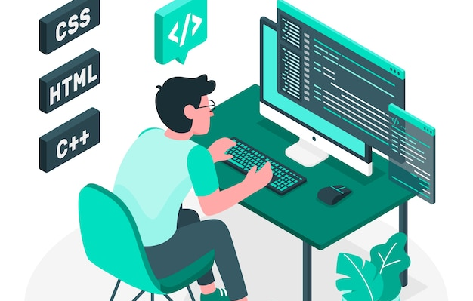

Programmer vs Coder

Slide 4

.net interactive notebooks
Notes:
We have some tolls like jupyter notebook
We need bring our code and our important note together. What is .NET interactive notebooks?

Slide 5

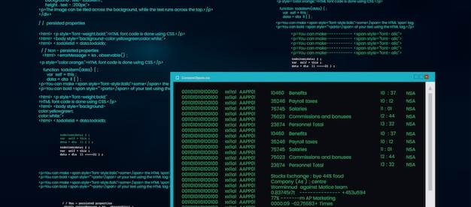

New Project

Slide 6
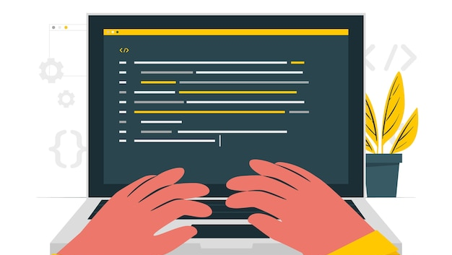
Sync NameSpace

